Slide 1


Bookworm –library
Norbert Balogh
Nándor Tápai

Slide 2
Problem
no standardized platform for libraries
old and obsolete library systems (DOS or paper based)
Solution
new user-friendly library system for everybody
digitalization every step
easy daily use for everybody

Slide 3
Functions of the system
Desktop:
- login (Admin & librarian)
- full Library administration
User management & Book management
Mobile App:
- login (& password reset)
- profile management
- check – Books & Outstanding Books and personal history
Website:
- get to know the library
- check categories and books
- registration

Slide 4






System architecture
5 parts of the system:
Database – MySQL
Backend – Spring Boot with Java 11
Mobile – Ionic React
Web – Vue JS
Desktop – C# WPF

Slide 5
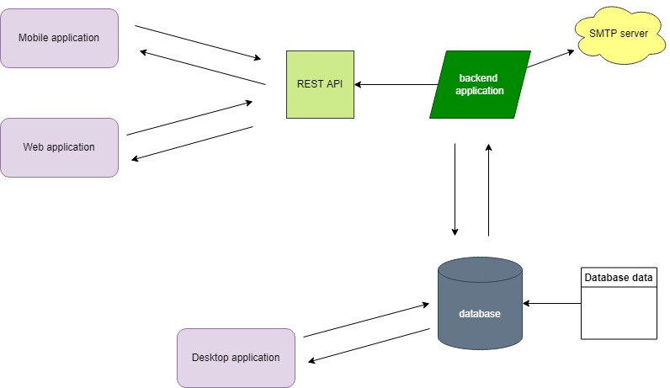
System architecture

Slide 6
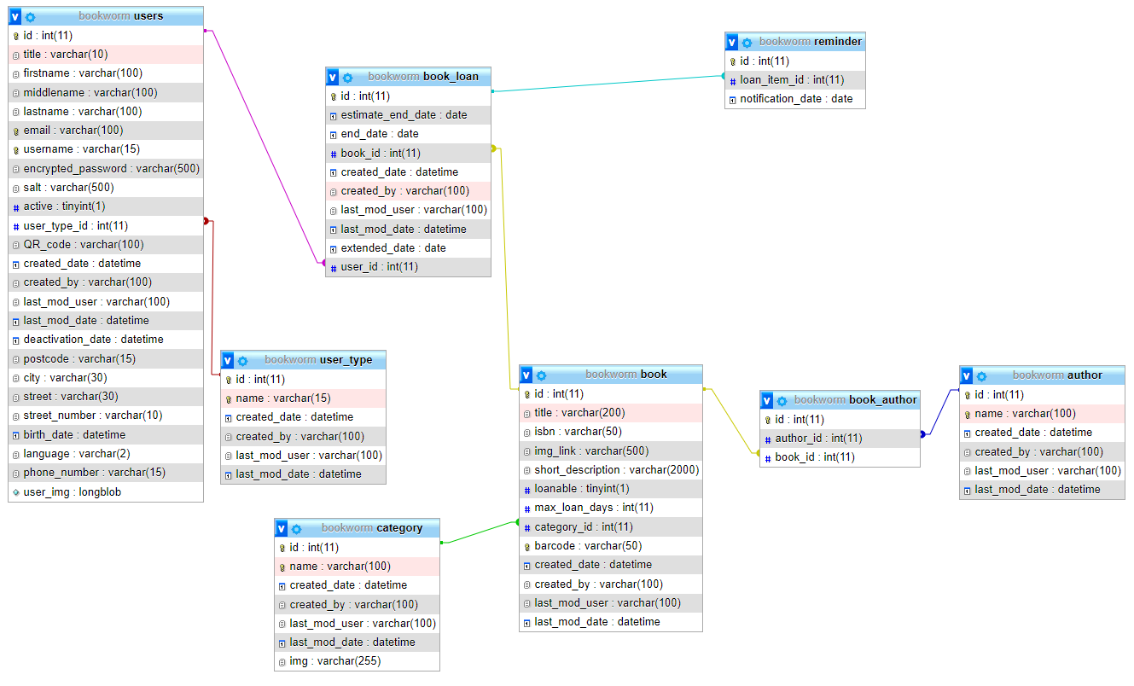
Database - MySQL

Slide 7
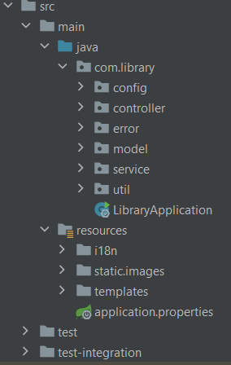
Backend
Framework: Spring Boot 2.5+
Language: Java 11
“Modules”:
Spring Web, String Data JPA,
Spring Mail, Spring Security
Spring Fox (Swagger)
JUnit5, Mockito
Lombok

Slide 8
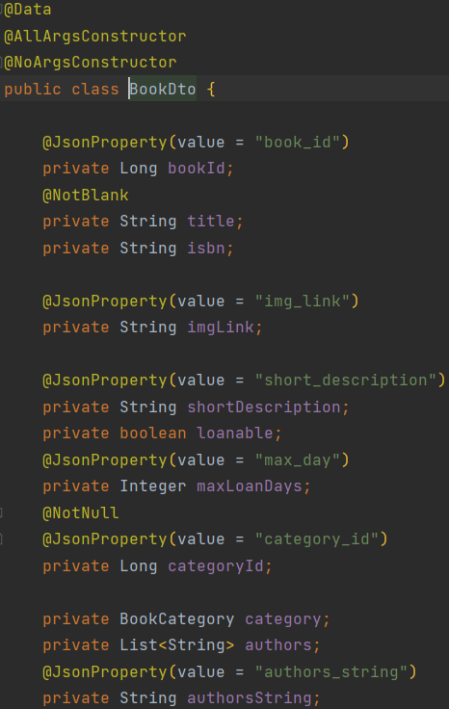
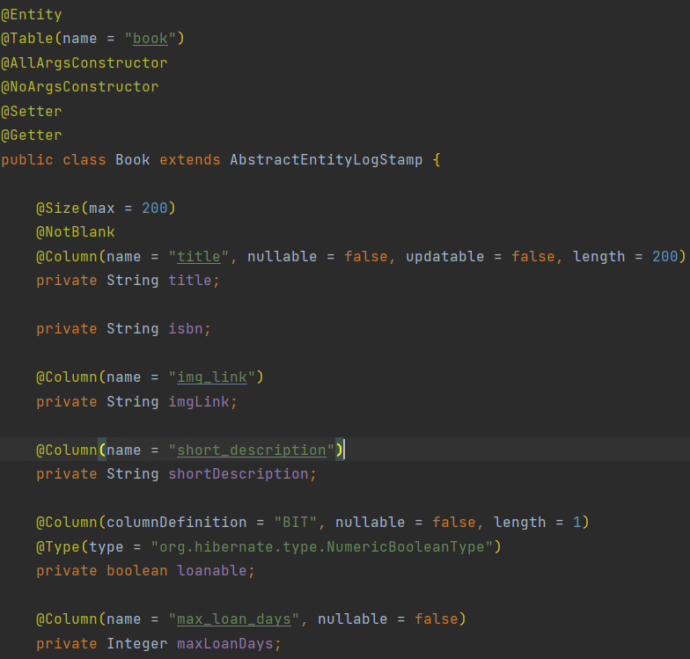
Backend – Entity & DTO

Slide 9
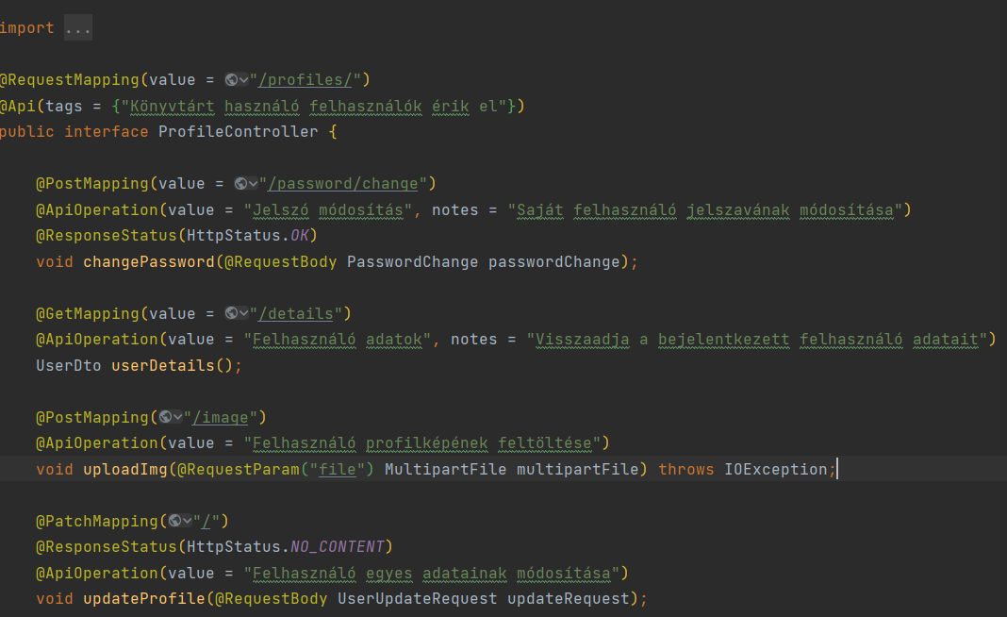
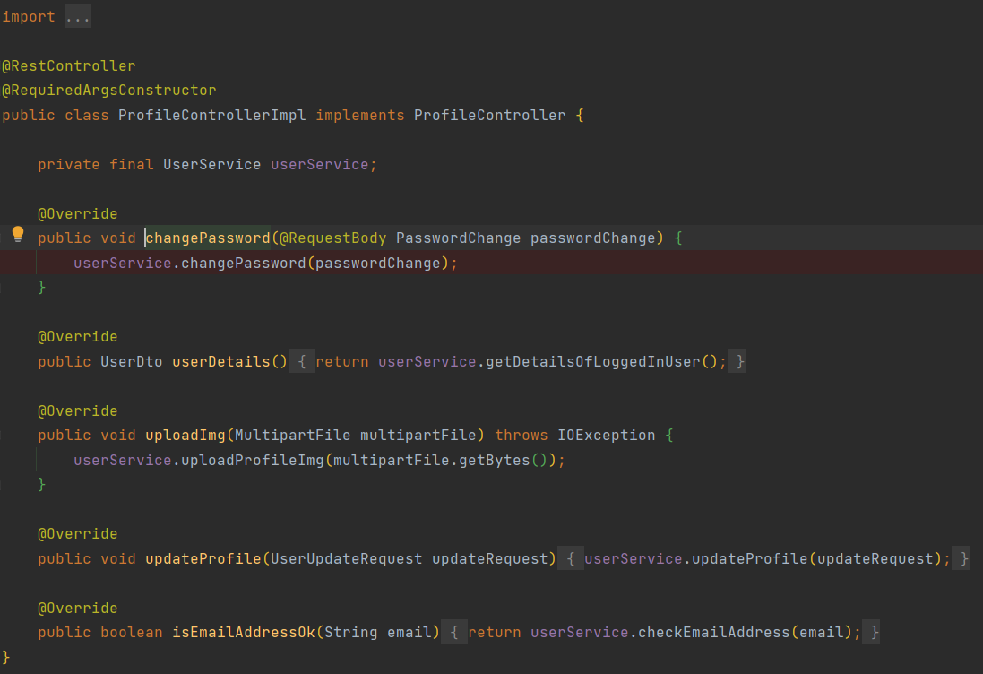
Controllers

Slide 10
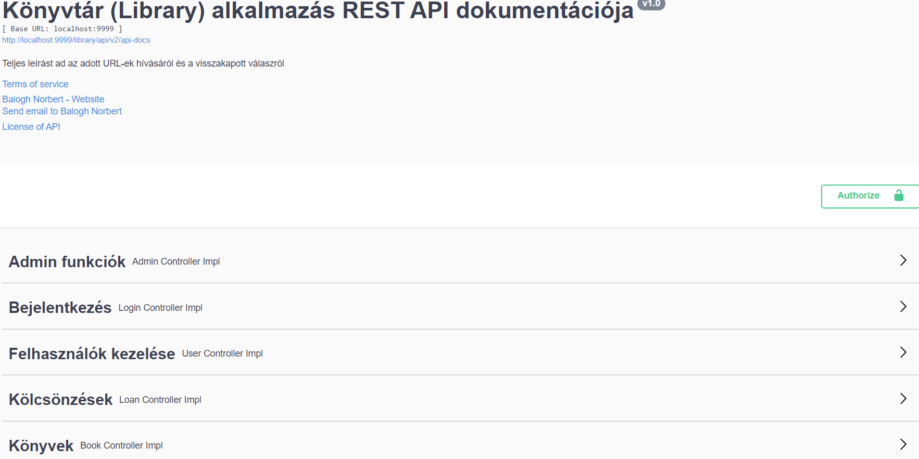
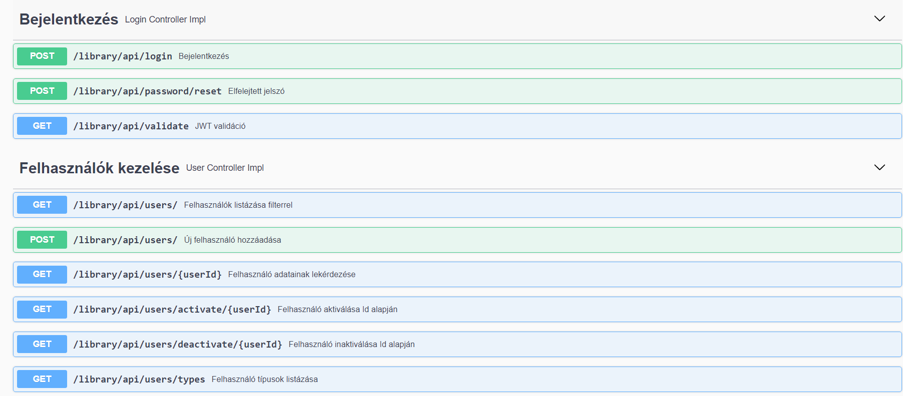
Backend - swagger

Slide 11
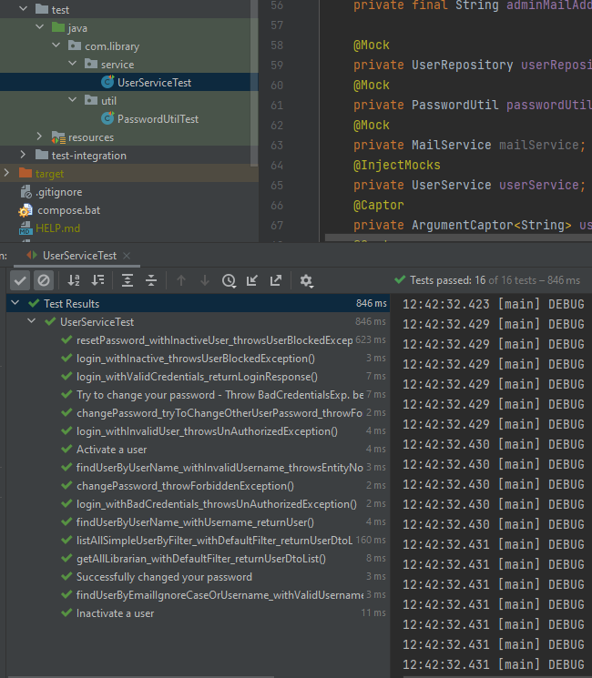
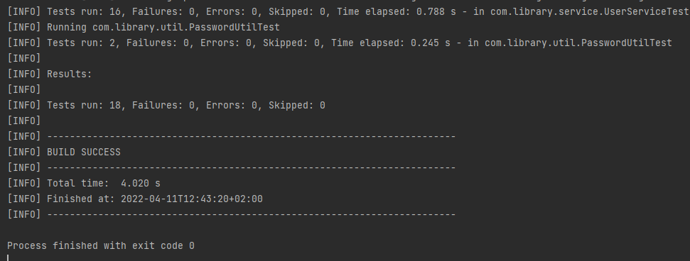
Backend - tests

Slide 12
Mobile Application
Framework : ionic (react)
Language : Typescript
Required node version: 16.14.2

Slide 13
Mobile - funcionality
Only for “simple” users
Login
Personal details
Books, borrowed books
Future developments:
admin & librarian account
“Pre-order” for users

Slide 14
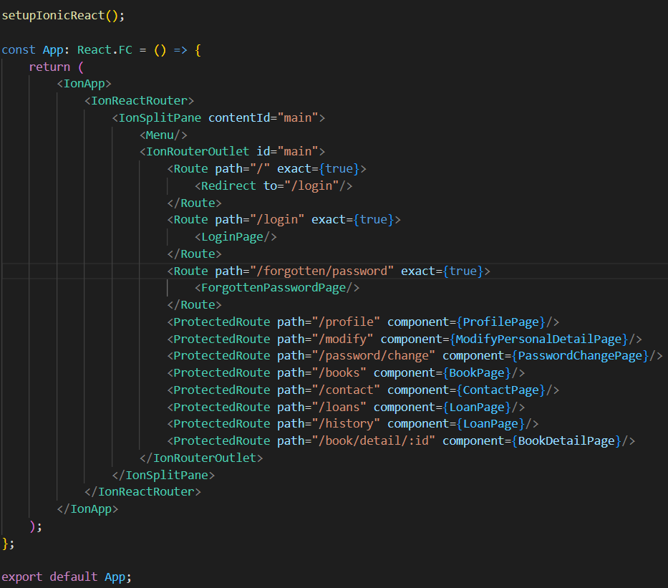
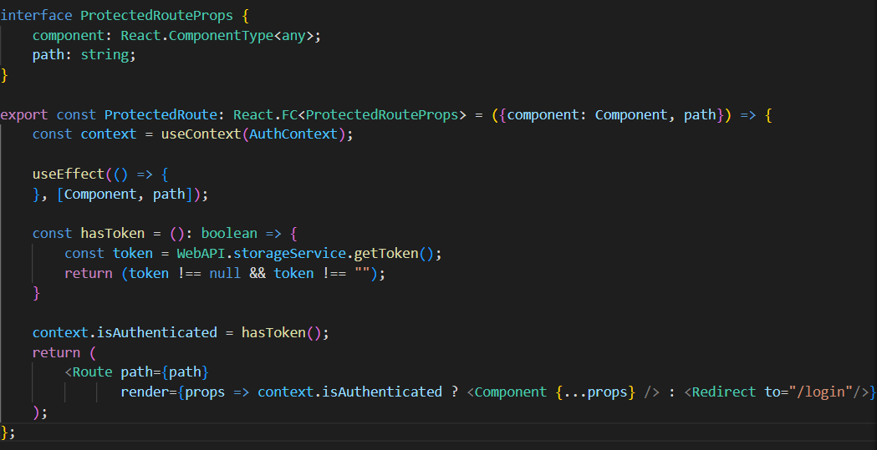
Mobile Application – protected router

Slide 15
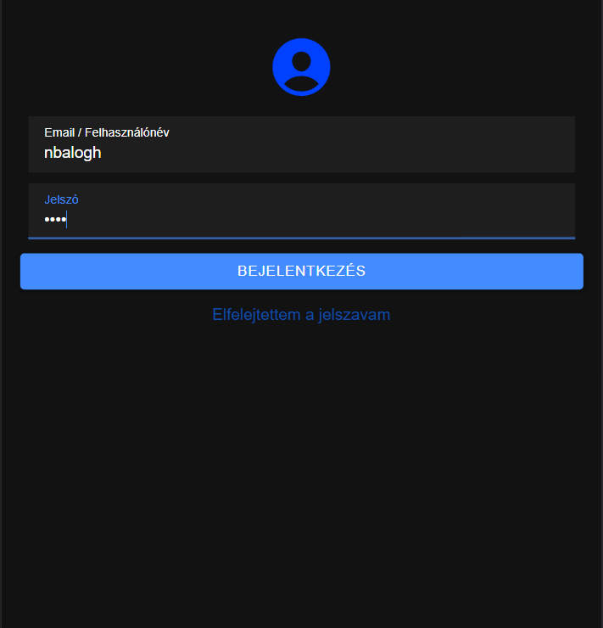
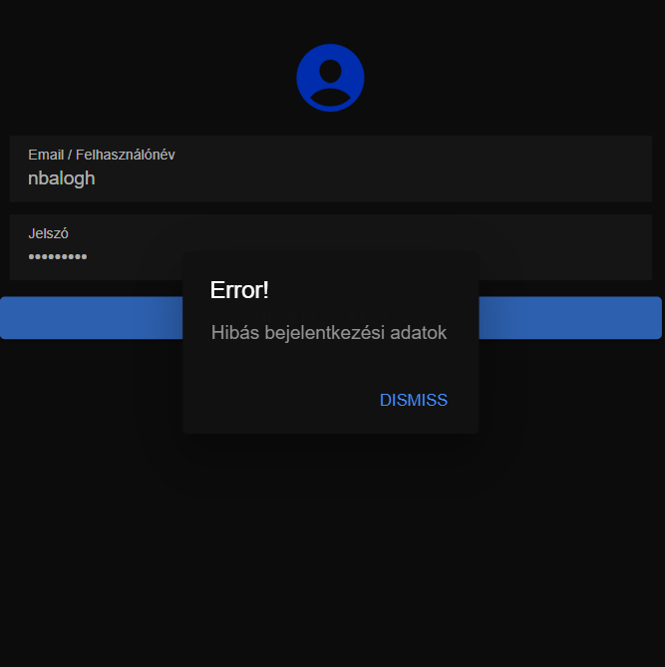
Mobile – Login page

Slide 16
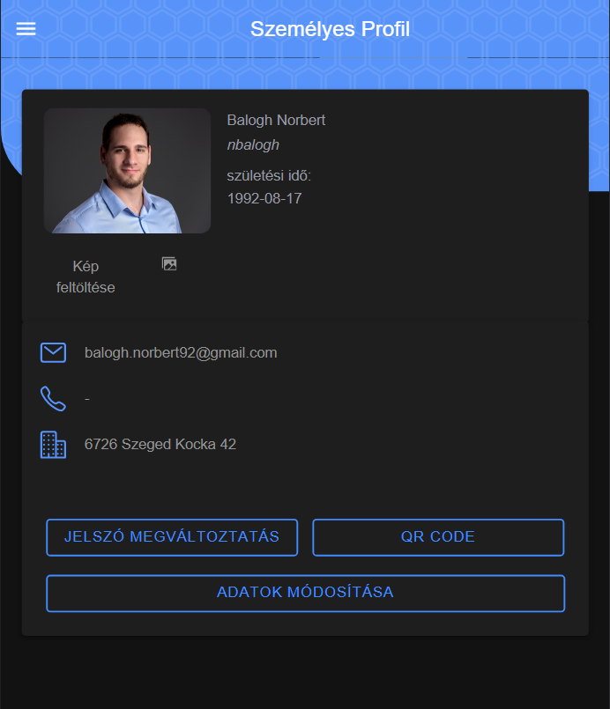
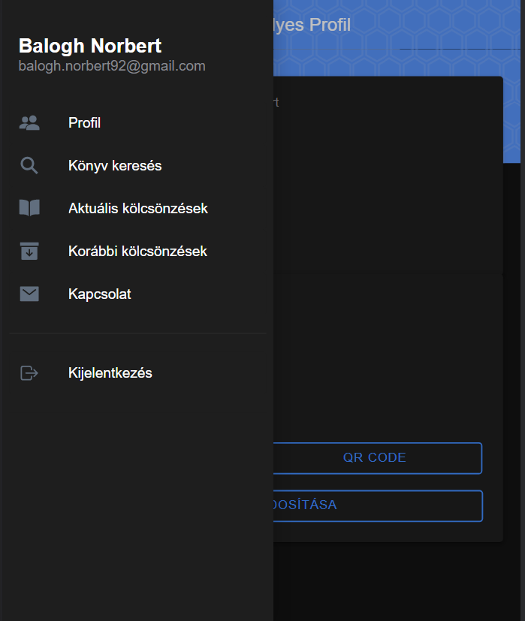
Mobile – Personal Details

Slide 17
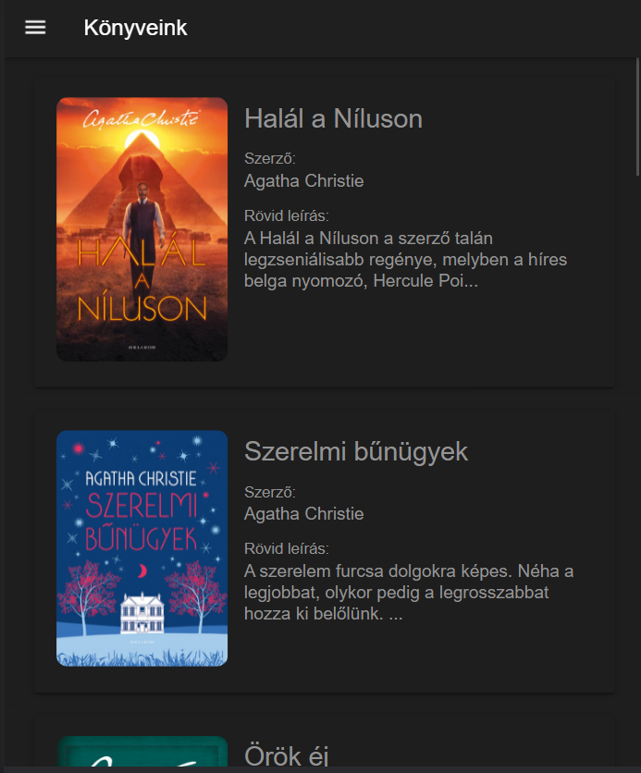
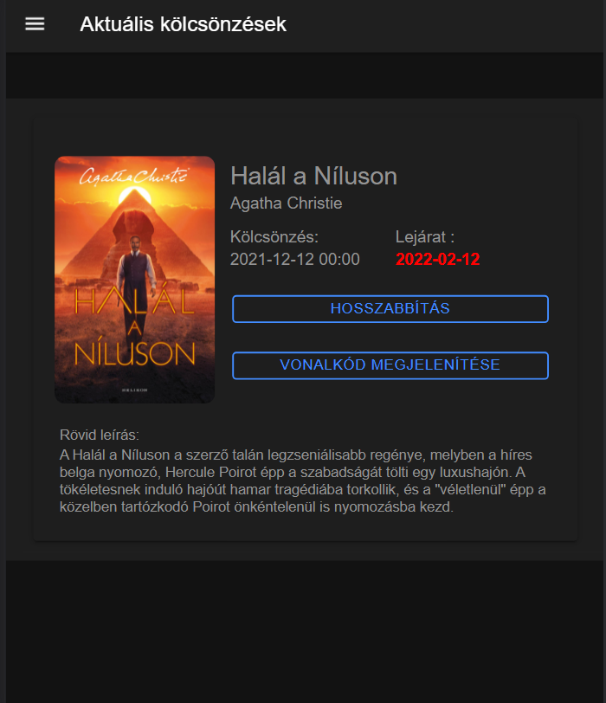
Mobile – Books

Slide 18
Web Application – Vue Js
Technology: Vue Js
Search available books
Contact page → send email to us
Registration

Slide 19
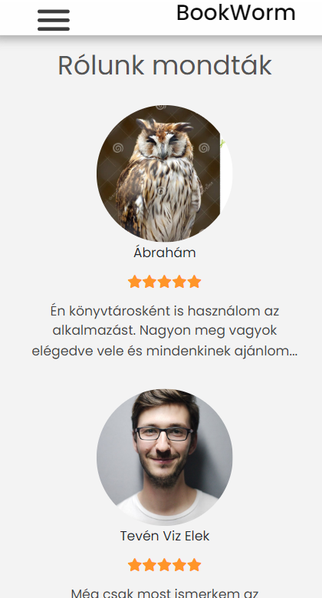
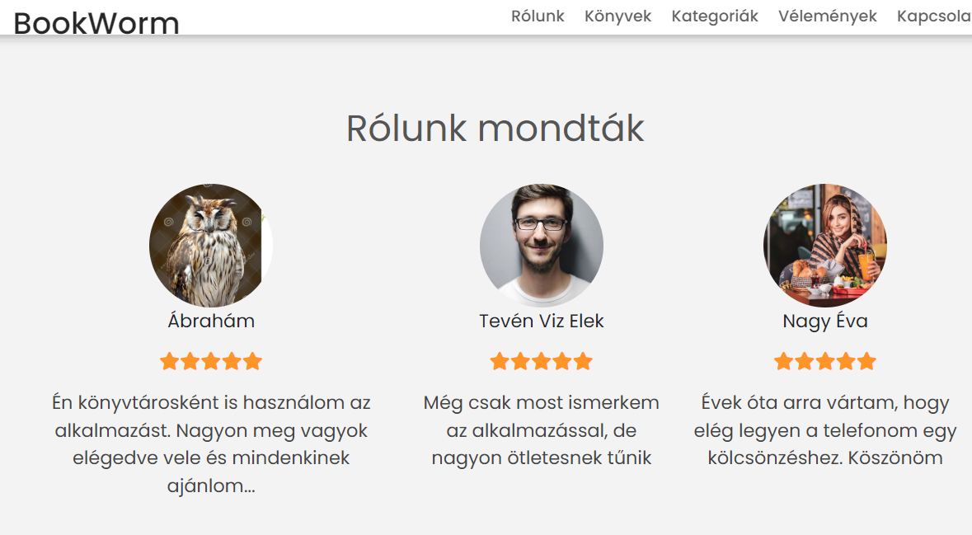
Responsivity
- Optimized for every device

Slide 20
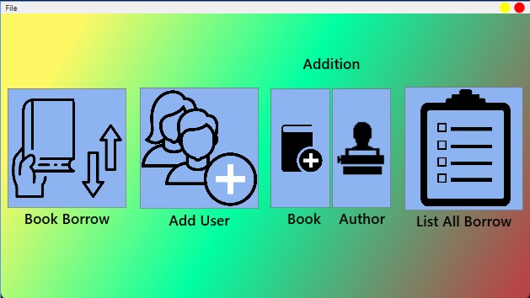
DESKTOP PROJECT
Framework: .NET
Language: C# /WPF

Slide 21
Desktop - funcionality
For Librarians
Login.
User search by QR code or RFID.
Book search with barcode.
Insert new users to the database.
Insert new books to the database.
Insert new author to the database.
Insert new loans to the database.
Check all active loans.
For Admins
Login
Check all Admins.
Check all Librarians.
Cheak all User.
Deactivate or Activate all user.

Slide 22
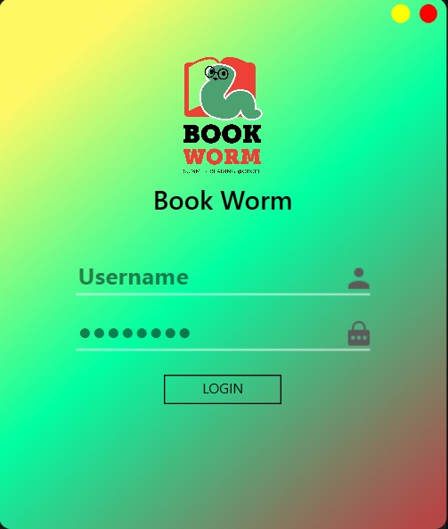
Desktop - Login

Slide 23
Dekstop Librarian Menu

Slide 24
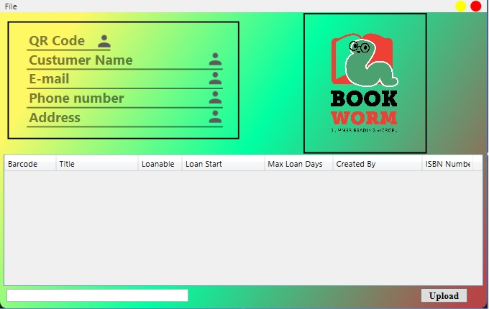
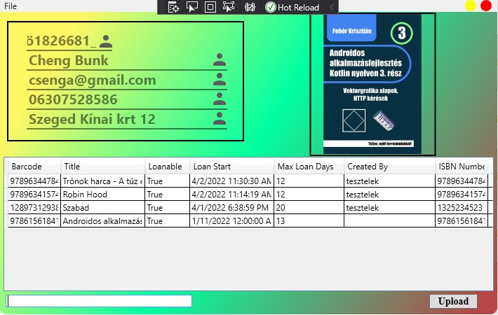
Desktop Borrow Page

Slide 25
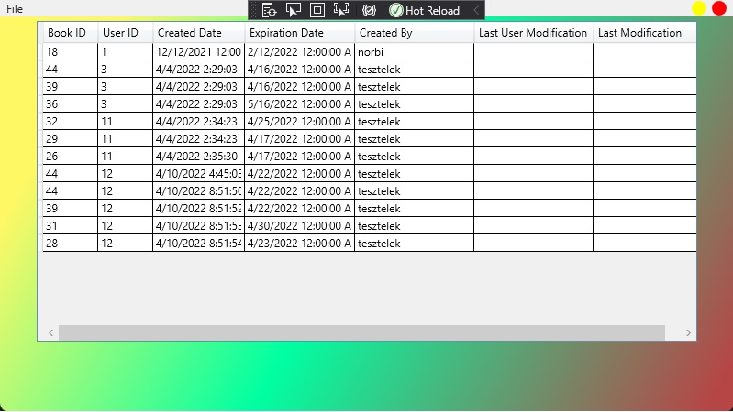
Desktop Active Borrow Page

Slide 26
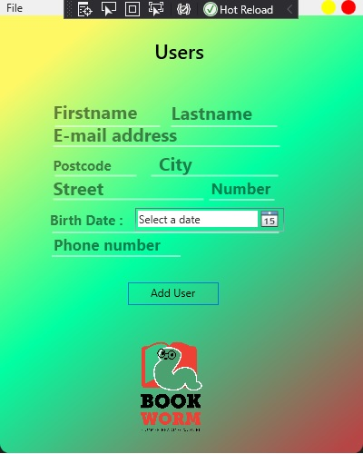
Desktop Insert User Page

Slide 27
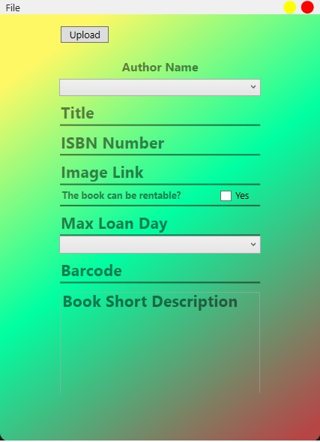
Desktop Insert New Book

Slide 28
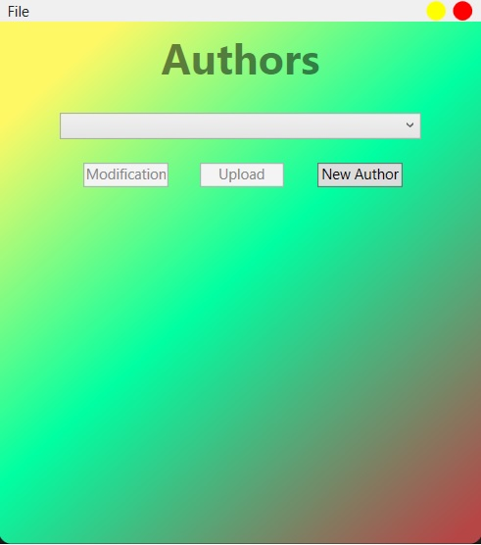
Desktop Insert New Author

Slide 29
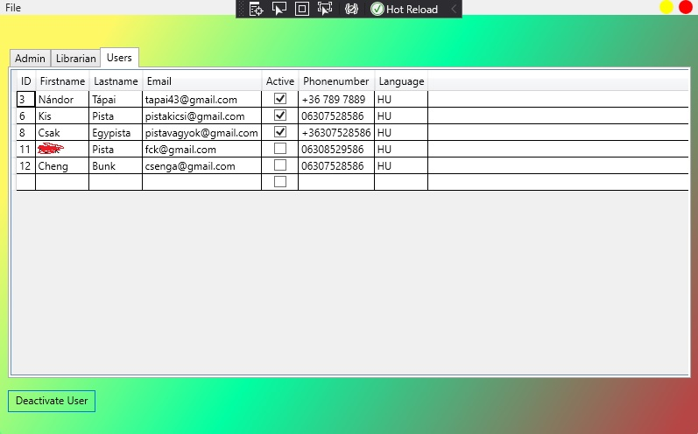
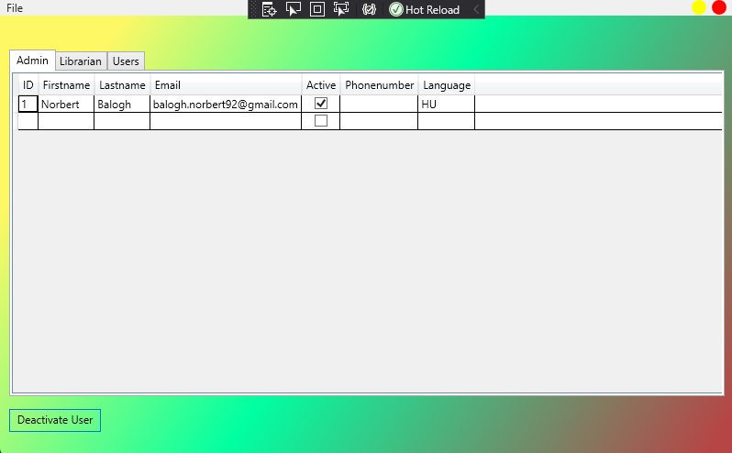
Desktop Admin Page

Slide 30
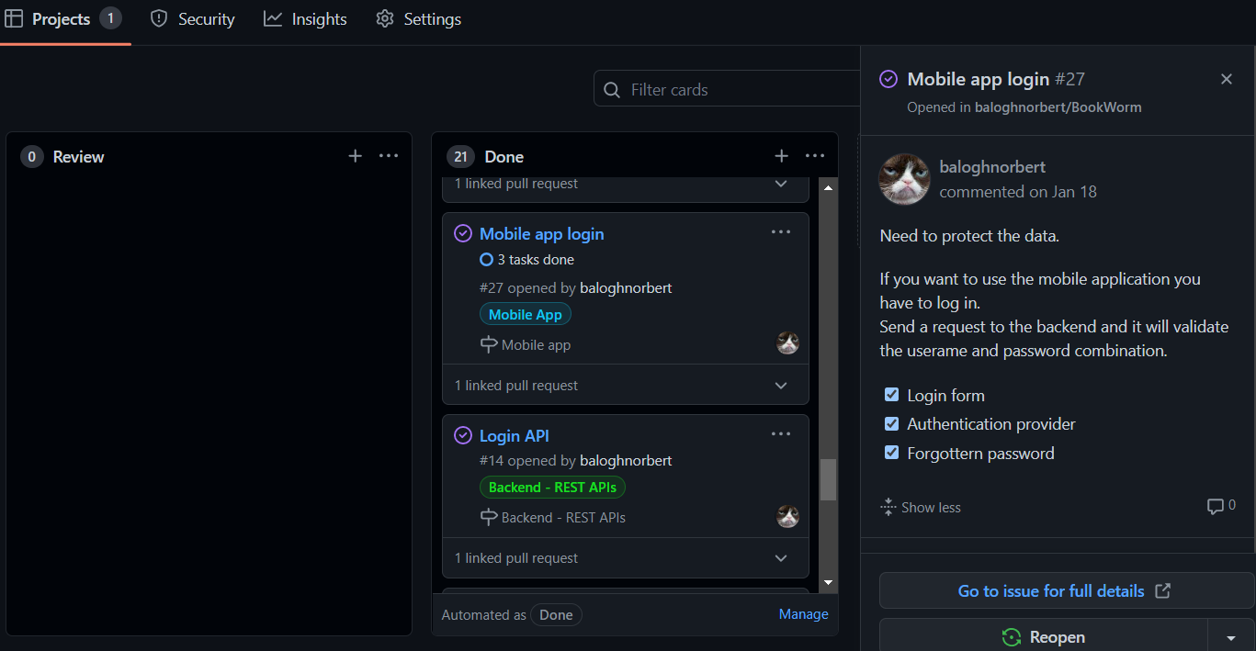

Teamwork
GitHub
Clean Code

Slide 31
Teamwork
Norbert Balogh
Backend & Mobile App.
Nándor Tápai
C# WPF
Made together
Design and Planning
Database
Web Application
Testing
Documentation

Slide 32
Feature plans
Mobile application for admins & librarians too
QR code scanning → faster identification
Preorder functionality
Extend web application functionality

Slide 33
THANKS!
ANY QUESTIONS?

